Slide 1
moneymitra ai agent
CAPSTONE PROJECT
Student Name : Atul Sharma
College Name & Department : ITS ENGINEERING COLLEGE GREATER NOIDA (BTech-CSE)

Slide 2
OUTLINE
Problem Statement
Technology used
Wow factor
End users
Result
Conclusion
Future scope
IBM Certifications
Git-hub Link

Slide 3
Problem Statement
In today's rapidly digitizing economy, a large portion of the population—especially in rural and semi-urban areas—lacks the essential knowledge and confidence to use digital financial tools such as UPI, internet banking, digital wallets, and online loan platforms.
This gap in financial literacy often leads to:
- Misuse of services
- Increased vulnerability to online frauds and scams
- Poor personal financial decisions
- Traditional awareness programs are limited in reach, language support, and personalization. There is a pressing need for a scalable, multilingual, AI-driven solution that provides accurate, real-time, and user-friendly financial education tailored to individual needs.

Slide 4
proposed solution
An AI Agent powered by IBM Granite model and deployed on IBM Cloud Lite, using Retrieval-Augmented Generation (RAG), to deliver interactive financial literacy support in simple language. It helps users safely navigate digital financial services and empowers them with knowledge to make smarter money decisions.

Slide 5
Technology used
IBM Cloud Lite Services:
Hosting the AI application using Watsonx tools with limited but sufficient compute resources for prototyping and deployment.
IBM Watsonx.ai:
Used to build and test prompts.
IBM Granite Foundation Model
Large Language Model (LLM) for answering user queries in natural, simple language.
Retrieval-Augmented Generation (RAG)
Combines search (retrieval) and generation for accurate and context-aware answers.
NLP
Supports queries and responses in multiple languages

Slide 6
IBM cloud services used
IBM Watsonx.ai Studio : To design, test, and refine prompts for the AI agent.
IBM Watsonx.ai Runtime : Executes AI model calls (Granite LLM) during live interactions with users.
IBM Granite Foundation Models : Natural language understanding and response generation.
IBM Cloud Object Storage : To store financial FAQs, policy documents, and educational content in a centralized location.
IBM Cloud Lite Account : It's used to experiment, develop, and deploy lightweight cloud applications

Slide 7
Wow factors
Multilingual Financial Guidance : Supports queries in regional languages (like Hindi, Tamil, Bengali, etc.) to help diverse users understand digital finance in their own language.
AI-Powered Real-Time Responses : Uses IBM Granite LLM and RAG to generate instant, easy-to-understand answers about UPI, banking, savings, budgeting, etc.
Scam & Fraud Awareness Assistant : Actively educates users on how to detect and avoid common online financial frauds, phishing, and scams.
Smart Retrieval from Trusted Sources : Retrieves content from verified government and bank websites like RBI, NPCI, and SEBI using vector search and embeddings.
User-Friendly, No App Required : Can be deployed as a web-based chatbot—no need to download any app, making it accessible even on low-end devices.
Personalized Financial Learning : Responds to users based on their level of understanding—ideal for beginners, students, and senior citizens.
\

Slide 8
End userS
General Public (Urban & Rural) : Individuals seeking to understand UPI, digital banking, EMI, and budgeting
Students & Youth : Young adults starting to manage their finances independently.
Senior Citizens : Elderly individuals unfamiliar with smartphones and digital banking.
Small Business Owners & Vendors : Kirana store owners, street vendors, shopkeepers transitioning to UPI & QR code.
Women in Semi-Urban/Rural Areas : Women accessing financial services through government schemes or SHGs
Financial Literacy Campaigns / NGOs : Organizations promoting safe digital transactions and saving habits.
Government Schemes & CSC Centers : Common Service Centers (CSCs) or banks promoting digital banking adoption
Educators / Trainers : Teachers or trainers using it as a support tool in financial education programs

Slide 9
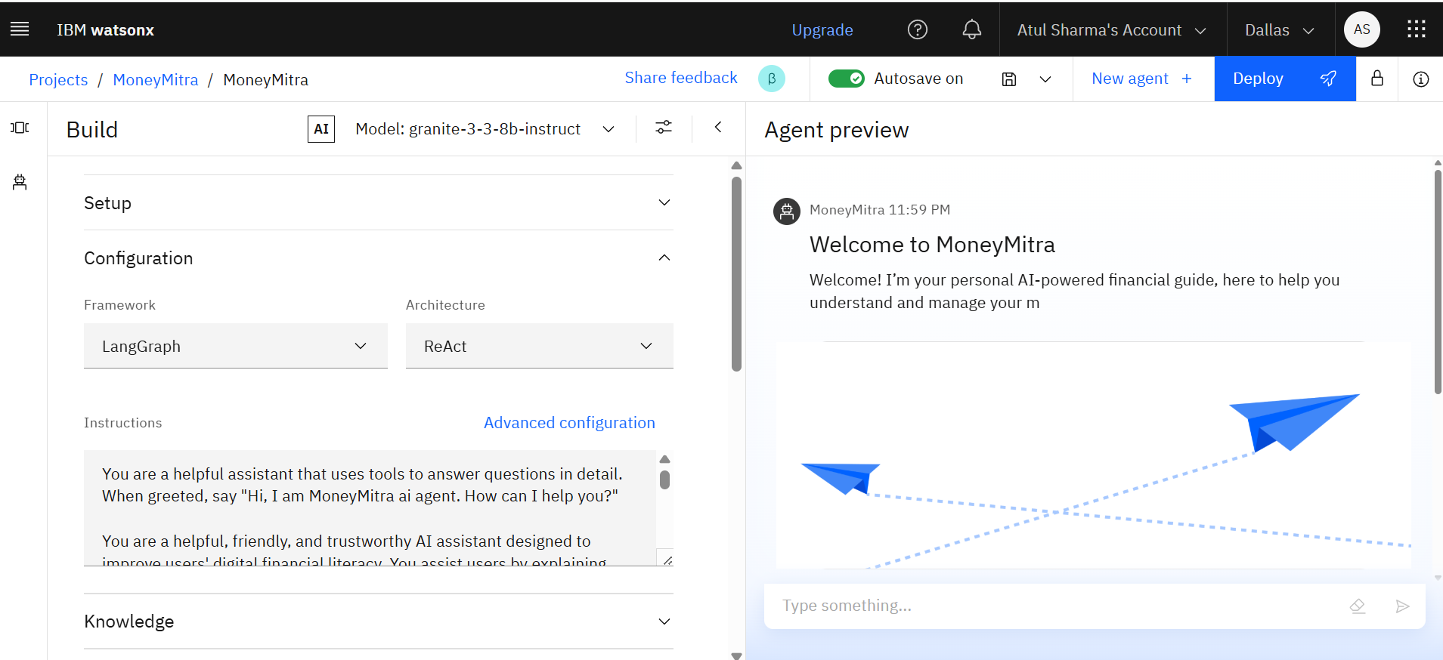
Results
Successfully deployed an AI Agent on IBM Cloud Lite :
Integrated IBM Watsonx and Granite model to deliver real-time, accurate, and multilingual responses to finance-related user queries.
Enabled users to understand and use digital financial tools safely :
Provided simplified guidance on UPI, online scams, budgeting, and digital payments, improving user confidence and awareness.

Slide 10
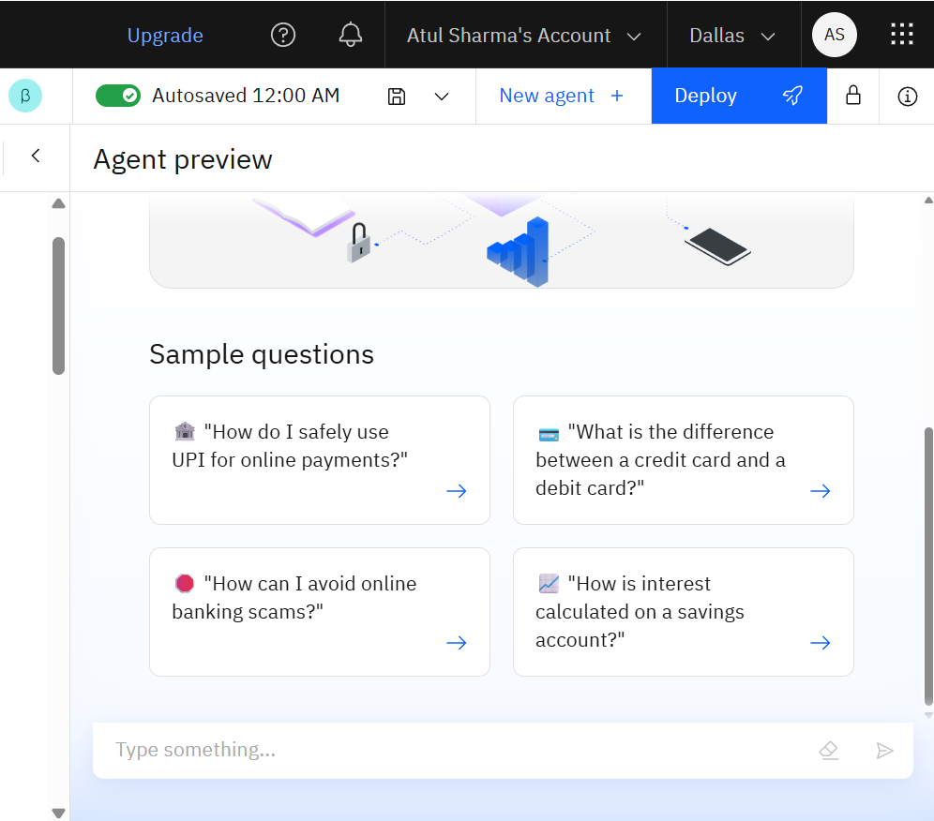
Results
Quick Start Question

Slide 11
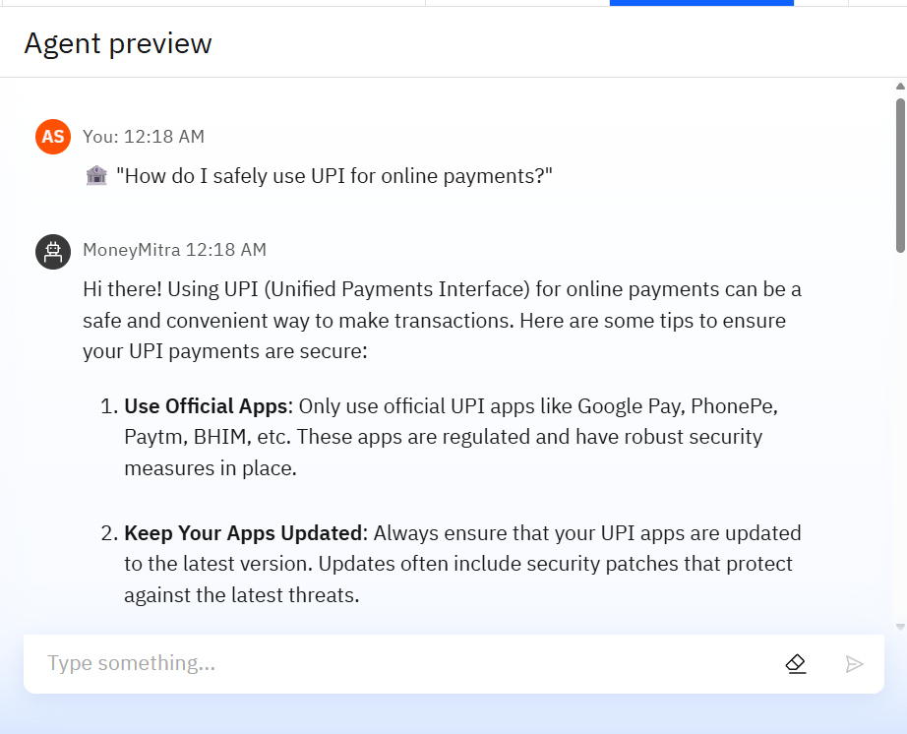
Results
Increased user confidence in digital financial platforms : Helped users avoid scams and make informed financial decisions.
Validated queries with real-world use cases and feedback : Tested questions like “How to use UPI safely?” and “What is EMI?” with successful results.

Slide 12
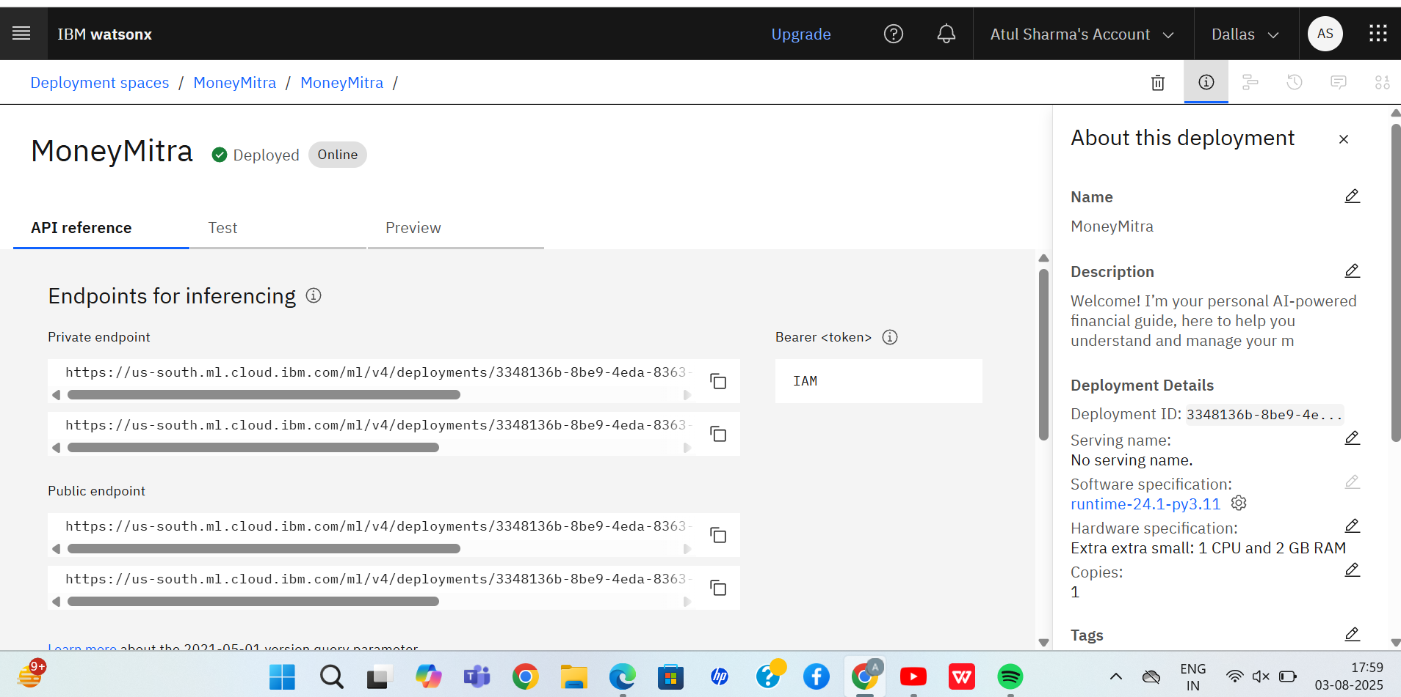
Results
Deployed AI Agent

Slide 13
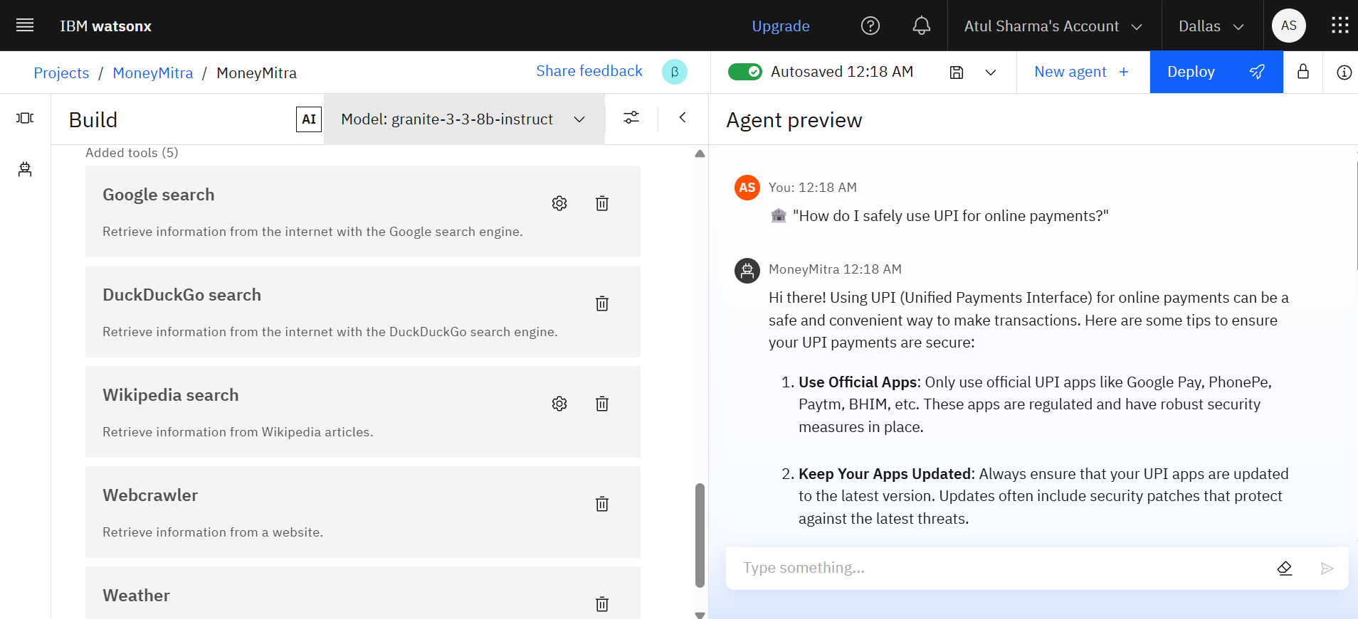
REsults
Tools Used

Slide 14
Conclusion
The AI Agent for Digital Financial Literacy successfully demonstrates how advanced AI technologies like IBM Granite and Retrieval-Augmented Generation (RAG) can be used to educate and empower users with essential financial knowledge.
By providing multilingual, real-time, and trustworthy guidance on digital financial tools such as UPI, online banking, and budgeting, the agent:
Bridges the gap between people and digital finance
Helps users avoid online scams and misuse
Encourages responsible money management, especially among underserved populations
The project showcases how AI, even on IBM Cloud Lite (free tier), can drive financial inclusion and support national goals like Digital India.

Slide 15
Future scope
Voice-Based Assistant Integration : Enable users to interact using voice commands in their native language, making it accessible to non-literate or elderly users.
Mobile App Deployment : Launch a lightweight Android/iOS app version for offline and on-the-go access in low-connectivity areas.
Integration with Real-Time Banking APIs : Provide live updates on interest rates, new schemes, loan offers, and financial news from trusted banking sources.
Gamified Financial Learning : Introduce quizzes, rewards, and learning levels to make financial education engaging and fun, especially for youth.
Advanced Fraud Detection Awareness : Expand the agent to provide scenario-based fraud detection simulations and alerts about trending scam patterns.

Slide 16
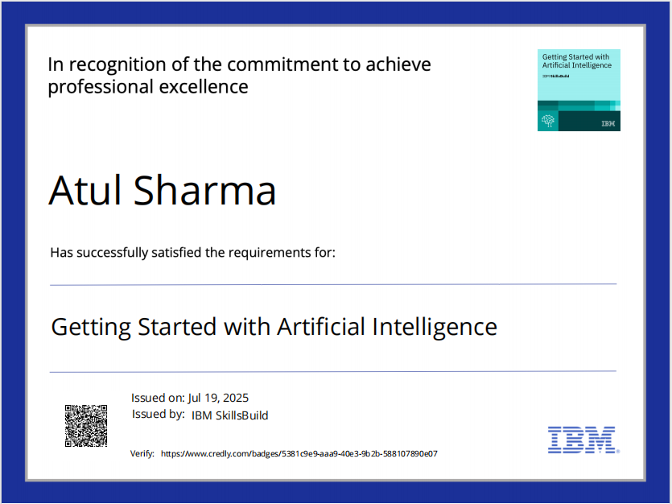
IBM Certifications
Screenshot/ credly certificate( getting started with AI)

Slide 17
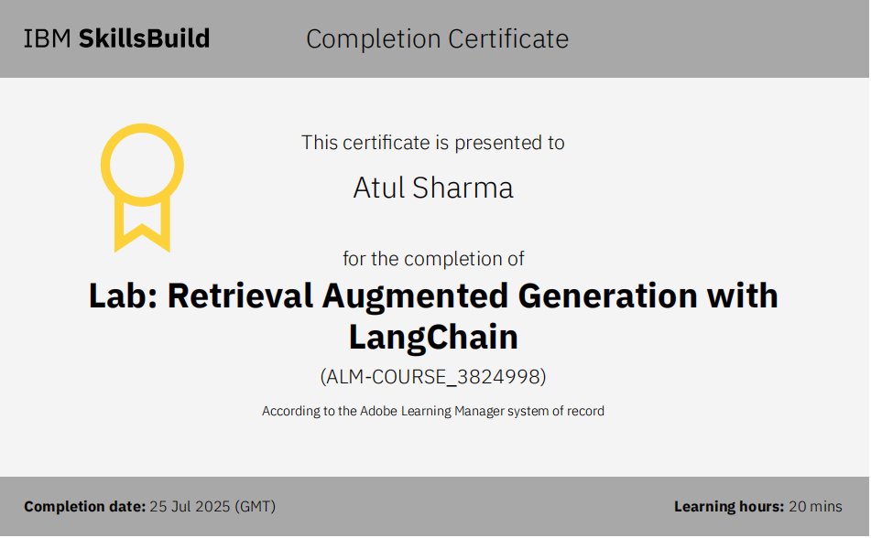
Attach your RAG LAB certificate here

Slide 18

GitHub Link
GitHub Link: https://github.com/AtulSharmaITS/MoneyMitra-AI-Agent

Slide 19
THANK YOU

